Slide 1
Unit III Hadoop I/O
Prof. Kritika Purohit
Assistant Professor
Department of Computer Science & Engineering

Slide 2
Points to be covered-
Hadoop Input output-writable interfaces
Writable class hierarchy and comparable classes
Writable class for java primitives
object writable and generic writable
Implementing raw comparator for speed, custom comparators

Slide 3
Hadoop Input output-writable interfaces
Hadoop writable Interface-
Writable is an interface in Hadoop. Writable in Hadoop acts as a wrapper class to almost all the primitive data type of Java.
Writables are used for creating serialized data types in Hadoop.
Serialization - Serialization is nothing but converting the raw data into a stream of bytes which can travel along different networks and can reside in different systems.
Serialization is not the only concern of Writable interface; it also has to perform compare and sorting operation in Hadoop.

Slide 4
Hadoop MapReduce uses implementations of Writables for interacting with user-provided Mappers and Reducers. To implement the Writable interface, we require two methods:
public interface Writable
{
void readFields(DataInput in);
void write(DataOutput out);
}

Slide 5
Why use Hadoop Writable(s)?
Hadoop framework needs Writable type of interface in order to perform the following tasks:
Implement serialization
Transfer data between clusters and networks
Store the deserialized data in the local disk of the system
Writable is a strong interface in Hadoop which while serializing the data, reduces the data size enormously, so that data can be exchanged easily within the networks.
It has separate read and write fields to read data from network and write data into local disk, respectively. Every data inside Hadoop should accept writable and comparable interface properties.

Slide 6
Comparable Class-
Comparable provides a single sorting sequence. In other words, we can sort the collection on the basis of a single element such as id, name, and price.
Comparable affects the original class, i.e., the actual class is modified.
WritableComparable interface is sub-interface of Hadoop’s Writable and Java’s Comparable interfaces. and its specification is shown below:
public interface WritableComparable extends Writable, Comparable
{
}

Slide 7
The standard java.lang.Comparable Interface contains single method compareTo() method for comparing the operators passed to it. Comparable Interface
public interface Comparable
{
Public int compareTo(Object obj);
}
The compareTo() method returns -1 , 0 , or 1 depending on whether the compared object is less than, equal to, or greater than the current object.

Slide 8
Implementation of writable is like implementation of interface in Java. It can be done by simply writing the keyword 'implements' and overriding the default writable method.
Some of the examples of writables are IntWritable, LongWritable, BooleanWritable and FloatWritable.
WritableComparable interface is just a sub interface of the Writable and java.lang.Comparable interfaces. For implementing a WritableComparable we must have compareTo method apart from readFields and write methods.
public interface WritableComparable extends Writable, Comparable {
void readFields(DataInput in);
void write(DataOutput out);
int compareTo(WritableComparable o) }

Slide 9
Comparison of types is crucial for MapReduce, where there is a sorting phase during which keys are compared with one another.
Implementing a comparator for WritableComparable like the org.apache.hadoop.io.RawComparator interface will help speed up our Map/Reduce (MR) Jobs. As we know a MR Job is composed of receiving and sending key-value pairs.
The process looks like the following.
(K1,V1) –> Map –> (K2,V2)
(K2,List[V2]) –> Reduce –> (K3,V3)

Slide 10
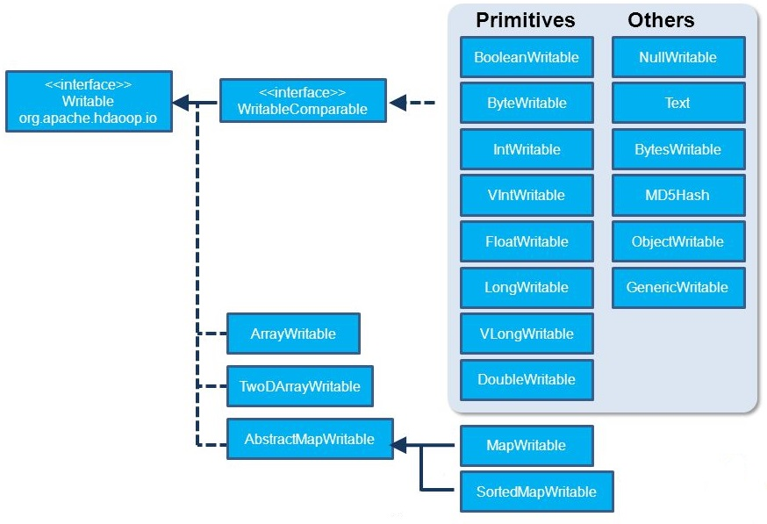
Writable class hierarchy

Slide 11
Writable class for java primitives
Hadoop provides classes that wrap the Java primitive types and implement the WritableComparable and Writable Interfaces. They are provided in the org.apache.hadoop.io package.
All the Writable wrapper classes have a get() and a set() method for retrieving and storing the wrapped value.
Primitive Writable Classes - These are Writable Wrappers for Java primitive data types and they hold a single primitive value that can be set either at construction or via a setter method. All these primitive writable wrappers have get() and set() methods to read or write the wrapped value.

Slide 12
Java Primitive | Writable Implementation | Serialized Value (Size)
Boolean | BooleanWritable | 1
Byte | ByteWritable | 1
Int | IntWritable | 4
 | VIntWritable | 1-5
Float | FloatWritable | 4
Long | LongWritable | 8
 | VLongWritable | 1-9
Double | DoubleWritable | 8

Slide 13
List of primitive writable data types available in Hadoop.
BooleanWritable
ByteWritable
IntWritable
VIntWritable
FloatWritable
LongWritable
VLongWritable
DoubleWritable
Serialized sizes of the above primitive writable data types are same as the size of actual java data type. So, the size of IntWritable is 4 bytes and LongWritable is 8 bytes.

Slide 14
Array Writable Classes- Hadoop provided two types of array writable classes, one for single-dimensional and another for two-dimensional arrays. But the elements of these arrays must be other writable objects like IntWritable or LongWritable only but not the java native data types like int or float.
ArrayWritable
TwoDArrayWritable
Map Writable Classes - Hadoop provided below MapWritable data types which implement java.util.Map interface.
AbstractMapWritable – This is abstract or base class for other MapWritable classes.
MapWritable – This is a general purpose map mapping Writable keys to Writable values.
SortedMapWritable– This is a specialization of the MapWritable class that also implements the SortedMap interface.

Slide 15
Other Writable Classes
NullWritable - NullWritable is a special type of Writable representing a null value. No bytes are read or written when a data type is specified as NullWritable. So, in Mapreduce, a key or a value can be declared as a NullWritable when we don’t need to use that field.
ObjectWritable- This is a general-purpose generic object wrapper which can store any objects like Java primitives, String, Enum, Writable, null, or arrays.
Text- Text can be used as the Writable equivalent of java.lang.String and It’s max size is 2 GB. Unlike java’s String data type, Text is mutable in Hadoop.
BytesWritable- BytesWritable is a wrapper for an array of binary data.
GenericWritable- It is similar to ObjectWritable but supports only a few types. User need to subclass this GenericWritable class and need to specify the types to support.

Slide 16
Implementing a Custom Writable
Hadoop comes with a useful set of Writable implementations that serve most purposes however, on occasion, you may need to write your own custom implementation.
With a custom Writable, you have full control over the binary representation and the sort order. Because Writables are at the heart of the MapReduce data path, tuning the binary representation can have a significant effect on performance.
The stock Writable implementations that come with Hadoop are well tuned, but for more elaborate structures, it is often better to create a new Writable type rather than composing the stock types.

Slide 17
import java.io.DataInput;
import java.io.DataOutput;
import java.io.IOException;
import org.apache.hadoop.io.Text;
import org.apache.hadoop.io.WritableComparable;
public class CustomWritable implements WritableComparable<CustomWritable> {
private Text first;
private Text second;
public CustomWritable( ) { // custom writable is constructor (default )

Slide 18
set(new Text(), new Text());
}
public CustomWritable(String first, String second) {
set(new Text(first), new Text(second));
}
public CustomWritable(Text first, Text second) {
set(first, second); passing objects
}
public void set(Text first, Text second) {
this.first = first;
this.second = second;
}
public Text getFirst() {
return first;
}
public Text getSecond() {
return second;
}
@Override
public void write(DataOutput out) throws IOException {
first.write(out);
second.write(out);
}

Slide 19
@Override
public void readFields(DataInput in) throws IOException {
first.readFields(in);
second.readFields(in);
}
@Override
public int hashCode() {
return first.hashCode() * 163 + second.hashCode();
}
@Override
public boolean equals(Object o) {
if (o instanceof CustomWritable) {
CustomWritable tp = (CustomWritable) o;
return first.equals(tp.first) && second.equals(tp.second);
}
return false;
}
@Override
public String toString() {
return first + "\t" + second;
}

Slide 20
@Override
public int compareTo(CustomWritable tp) {
int cmp = first.compareTo(tp.first);
if (cmp != 0) {
return cmp;
}
return second.compareTo(tp.second);
}
}

Slide 21
The first part of the implementation is straightforward: there are two Text instance variables, first and second, and associated constructors, getters, and setters.
All Writable implementations must have a default constructor so that the
MapReduce framework can instantiate them, then populate their fields by calling readFields().
Writable instances are mutable and often reused, so you should take care to avoid allocating objects in the write() or readFields() methods.
CustomWritable write() method serializes each Text object in turn to the output stream by delegating to the Text objects themselves.
Similarly, readFields() deserializes the bytes from the input stream by delegating to each Text object.

Slide 22
The DataOutput and DataInput interfaces have a rich set of methods for serializing and deserializing Java primitives, so, in general, you have complete control over the wire format of your Writable object. Just as you would for any value object you write in Java, you should override the hashCode(), equals(), and toString() methods from java.lang.Object.
The hashCode() method is used by the HashPartitioner (the default partitioner in MapReduce) to choose a reduce partition, so you should make sure that you write a good hash function that mixes well to ensure reduce partitions are of a similar size.
CustomWritable is an implementation of WritableComparable, so it provides an implementation of the compareTo() method that imposes the ordering you would expect it sorts by the first string followed by the second.

Slide 23
TextPair is an implementation of WritableComparable, so it provides an implementation of the compareTo() method that imposes the ordering you would expect: it sorts by the first string followed by the second.

Slide 24
Implementing a RawComparator for speed
In the above example, when TextPair is being used as a key in MapReduce, it will have to be deserialized into an object for the compareTo() method to be invoked.
since TextPair is the concatenation of two Text objects, and the binary representation of a Text object is a variable-length integer containing the number of bytes in the UTF-8 representation of the string, followed by the UTF-8 bytes themselves.
The trick is to read the initial length, so we know how long the first Text object’s byte representation is; then we can delegate to Text’s RawComparator, and invoke it with the appropriate offsets for the first or second string. Consider the following example for more details.

Slide 25
public static class Comparator extends WritableComparator
{
private static final Text.Comparator TEXT_COMPARATOR = new
Text.Comparator();
public Comparator() {
super(TextPair.class); }
@Override
public int compare(byte[] b1, int s1, int l1, byte[] b2, int s2, int l2) {
try {
int firstL1 = WritableUtils.decodeVIntSize(b1[s1]) + readVInt(b1, s1);
int firstL2 = WritableUtils.decodeVIntSize(b2[s2]) + readVInt(b2, s2);
int cmp = TEXT_COMPARATOR.compare(b1, s1, firstL1, b2, s2, firstL2);

Slide 26
if (cmp != 0) {
return cmp; }
return TEXT_COMPARATOR.compare(b1, s1 + firstL1, l1 - firstL1,
b2, s2 + firstL2, l2 - firstL2); }
catch (IOException e) {
throw new IllegalArgumentException(e); } } }
Static
{
WritableComparator.define(TextPair.class, new Comparator());
}

Slide 27
Custom comparators
As we can see with TextPair, writing raw comparators takes some care, since you have to deal with details at the byte level.
Custom comparators should also be written to be RawComparators, if possible. These are comparators that implement a different sort order to the natural sort order defined by the default comparator.
The following Example a comparator for TextPair, called FirstComparator, that considers only the first string of the pair. Note that we override the compare() method that takes objects so both compare() methods have the same semantics.
A custom RawComparator for comparing the first field of TextPair byte representations.

Slide 28
public static class FirstComparator extends WritableComparator
{
private static final Text.Comparator TEXT_COMPARATOR = new
Text.Comparator();
public FirstComparator()
{
super(TextPair.class); }
@Override
public int compare(byte[] b1, int s1, int l1,
byte[] b2, int s2, int l2)
{

Slide 29
Try
{
int firstL1 = WritableUtils.decodeVIntSize(b1[s1]) + readVInt(b1, s1);
int firstL2 = WritableUtils.decodeVIntSize(b2[s2]) + readVInt(b2, s2);
return TEXT_COMPARATOR.compare(b1, s1, firstL1, b2, s2, firstL2);
}
catch (IOException e)
{
throw new IllegalArgumentException(e);
}
}

Slide 30
@Override
public int compare(WritableComparable a, WritableComparable b)
{
if (a instanceof TextPair && b instanceof TextPair)
{
return ((TextPair) a).first.compareTo(((TextPair) b).first);
}
return super.compare(a, b);
}
}

